Slide 1
CS860: Artificial Intelligence Adversarial Search and Game Trees
Dr. Soyiba Jawed
[These slides adapted from Dan Klein and Pieter Abbeel]

Slide 2

Agents Getting along with Other Agents

Slide 3

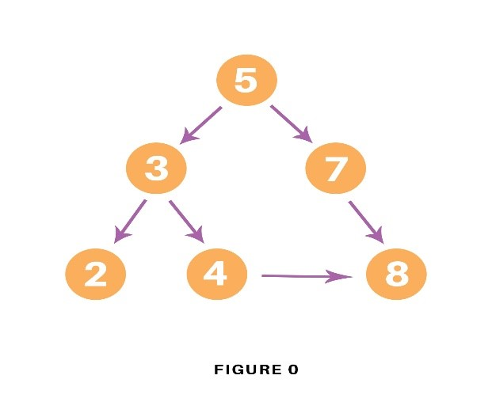
Agents Getting Along with Humans

Slide 4
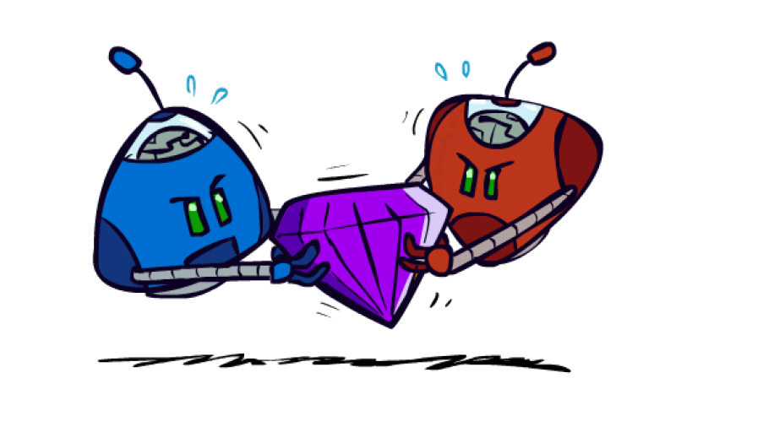
Adversarial Games

Slide 5
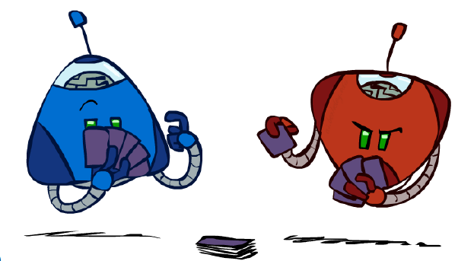
Types of Games
Many different kinds of games !
Axes:
Deterministic or stochastic?
One, two, or more players?
Zero Sum?
Perfect information(can you see the state)?
Want algorithms for calculating a strategy (policy) which recommends a move from each state

Slide 6
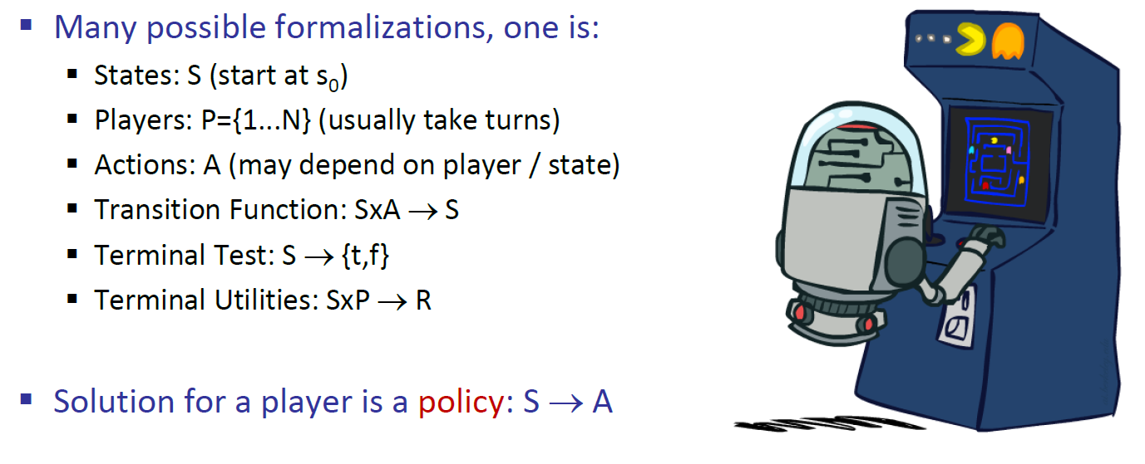
Deterministic Games with Terminal Utilities

Slide 7
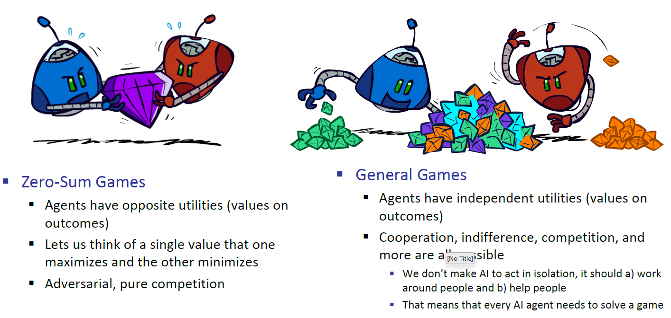
Types of Games

Slide 8
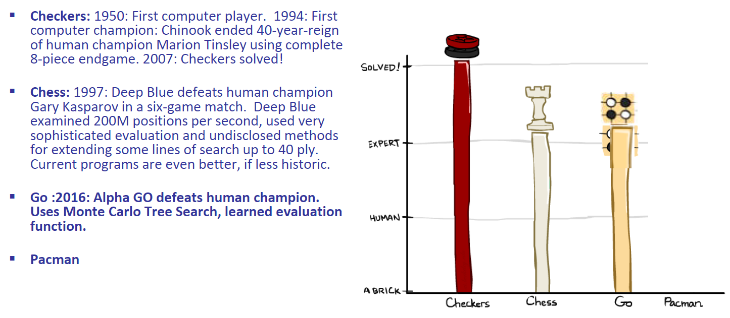
Zero Sum Games

Slide 9
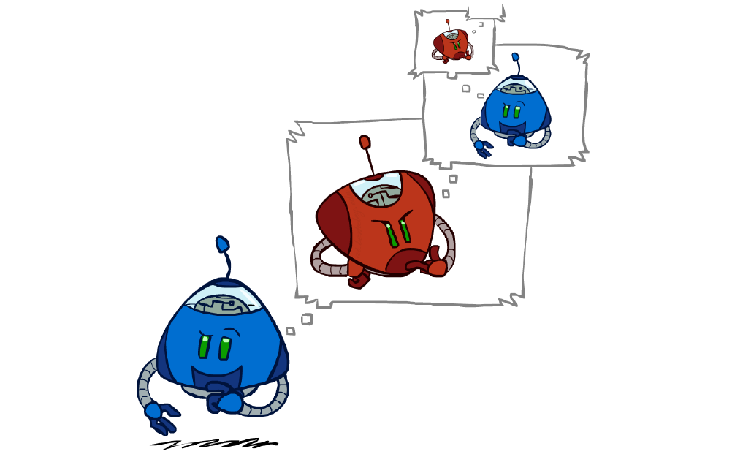
Adversarial Search

Slide 10
News: Cost -> Utility!
No longer minimizing cost!
Agent now wants to maximize its score/utility!

Slide 11
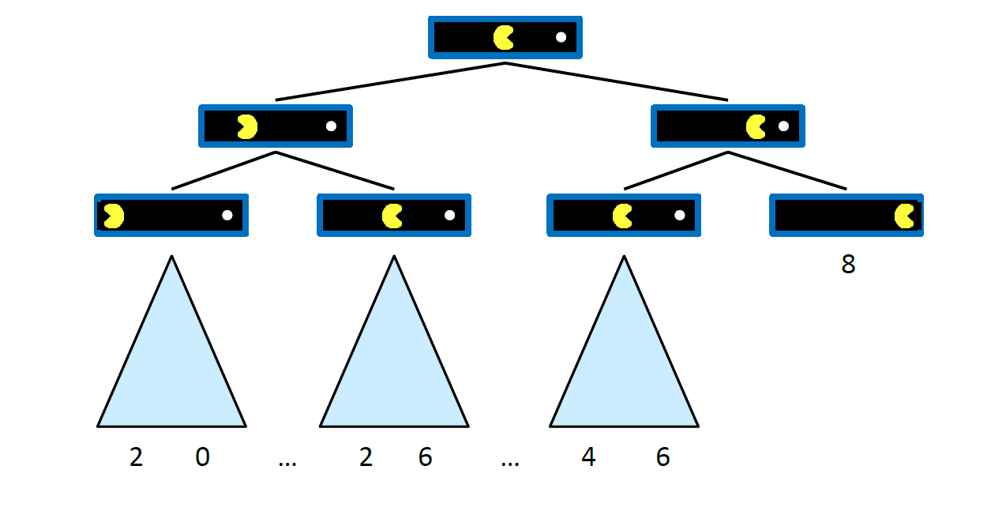
Single Agent Trees

Slide 12
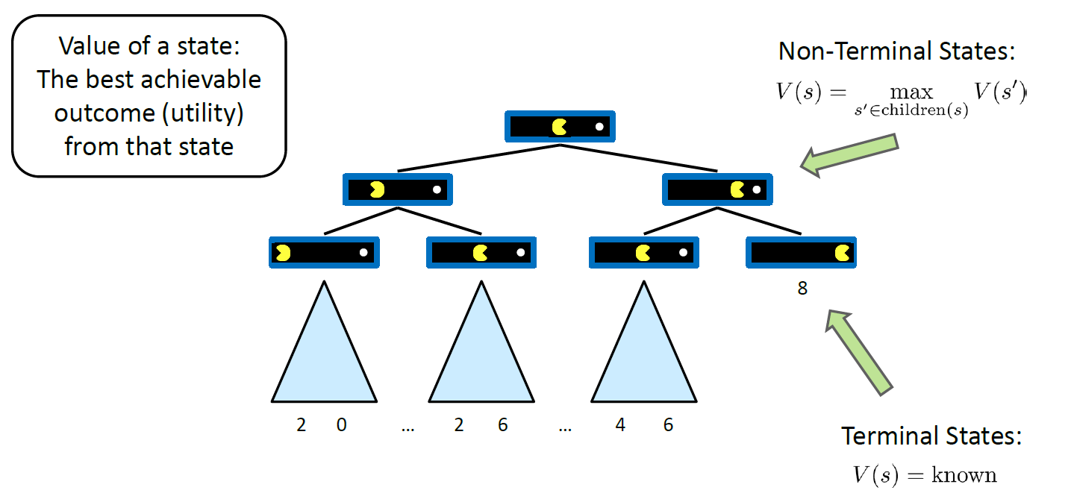
Value of a State

Slide 13
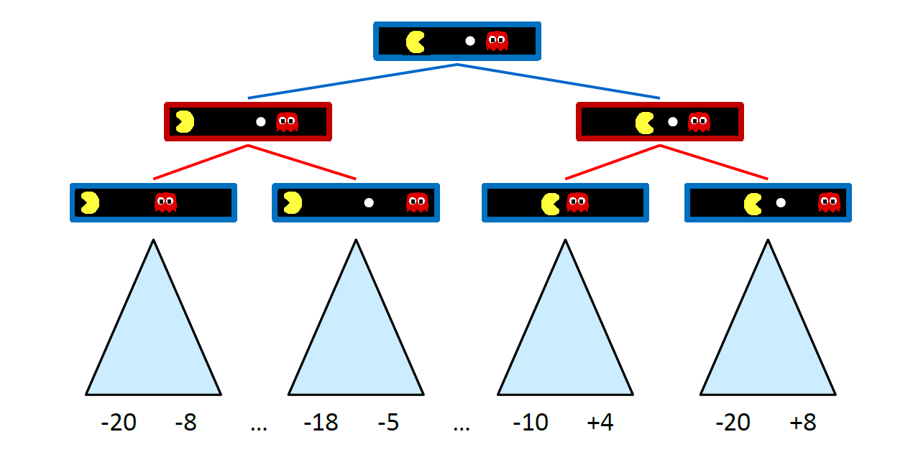
Adversarial Game Trees

Slide 14
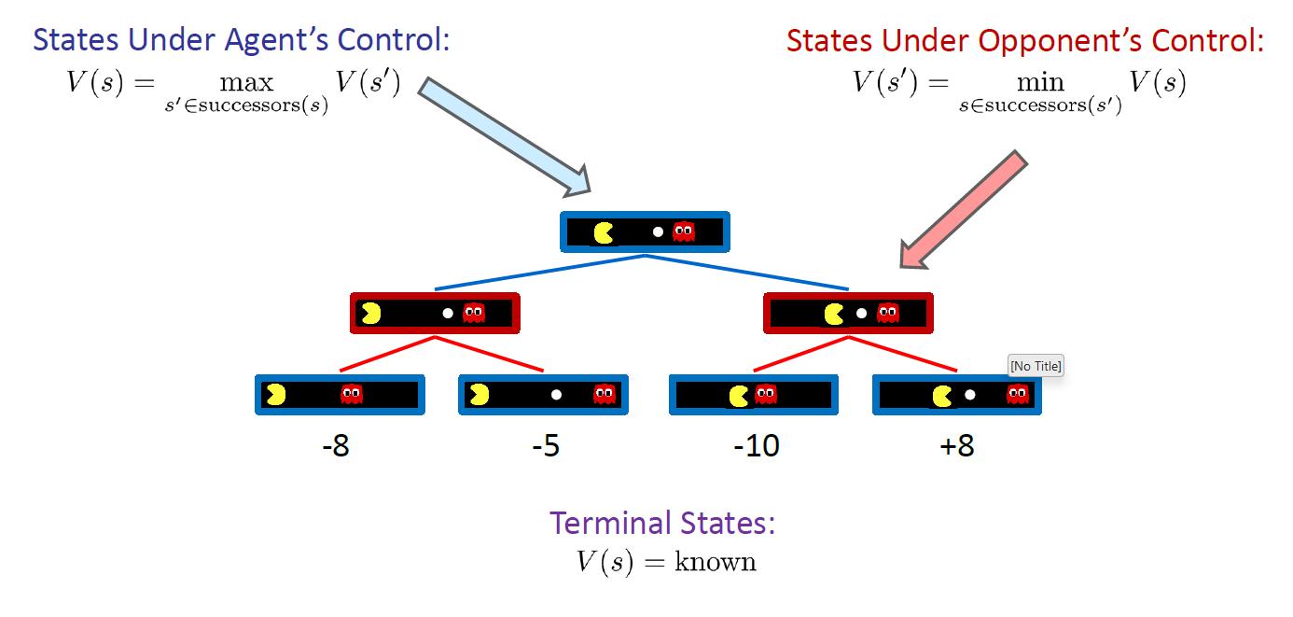
Min Max Values

Slide 15
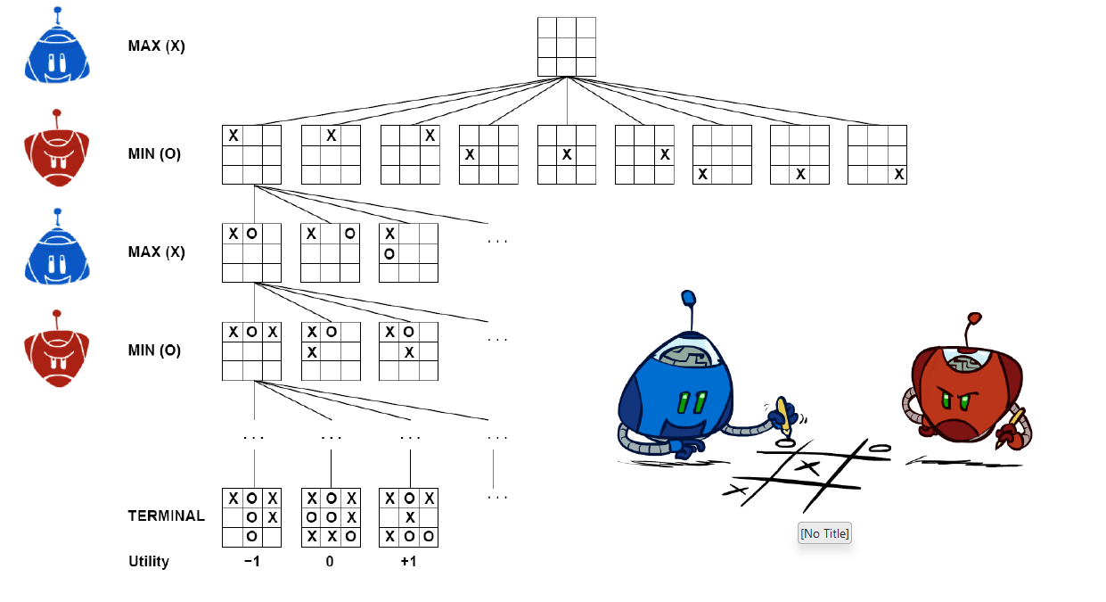
Tic-Tac-Toe Game Tree

Slide 16
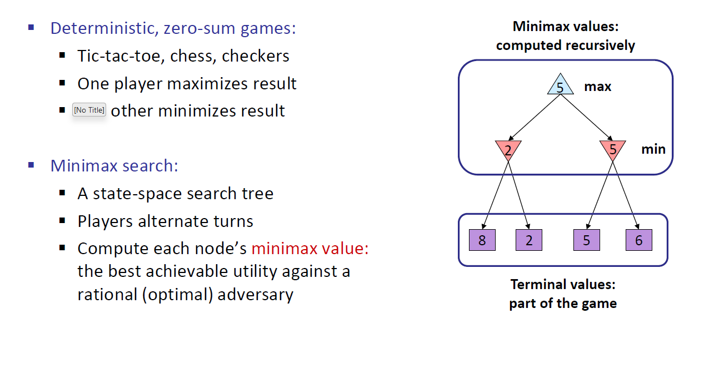
Adversarial Search (Minmax)

Slide 17
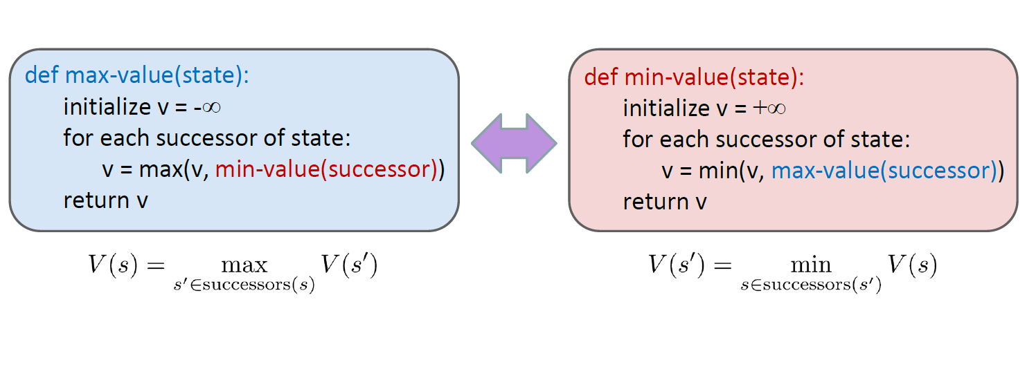
Minimax Implementation

Slide 18
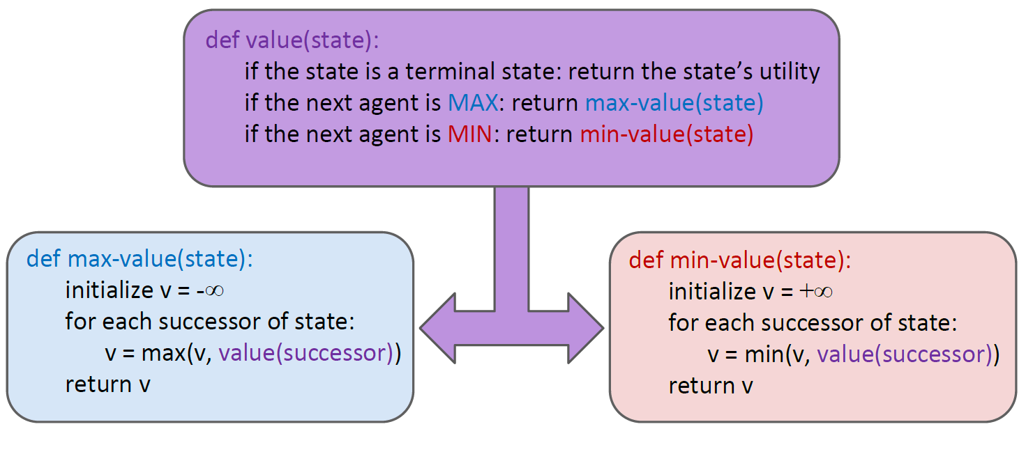
Minimax Implementation (Dispatch)

Slide 19
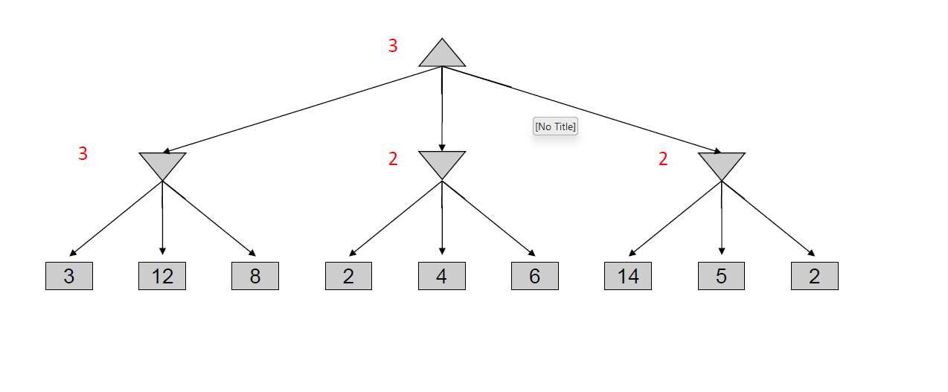
MiniMax Example

Slide 20
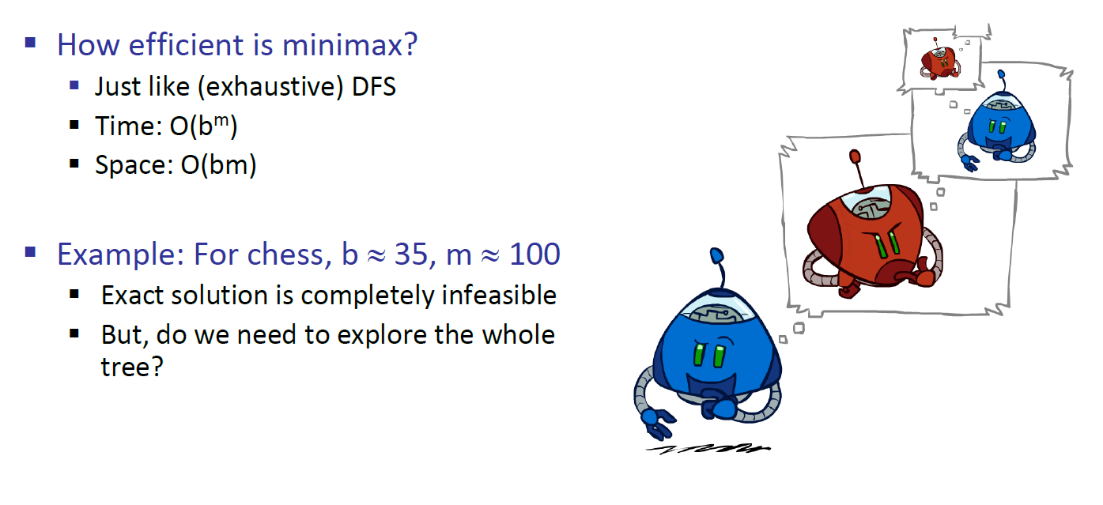
MiniMax Efficiency

Slide 21
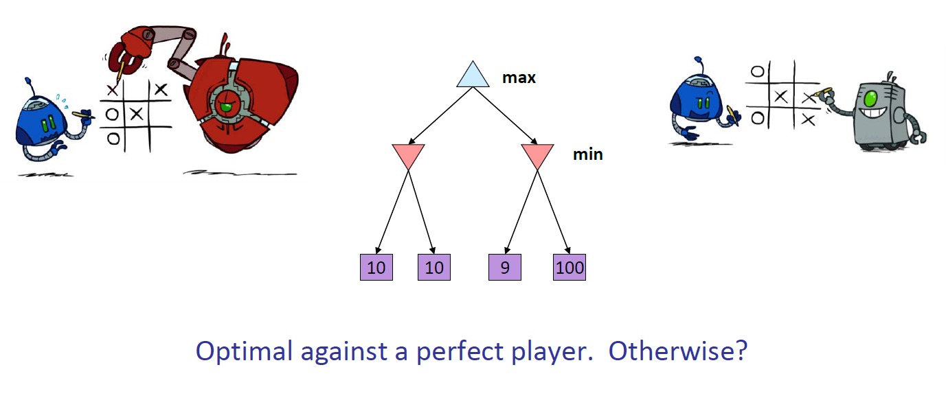
Minimax Properties

Slide 22

Resource limits

Slide 23
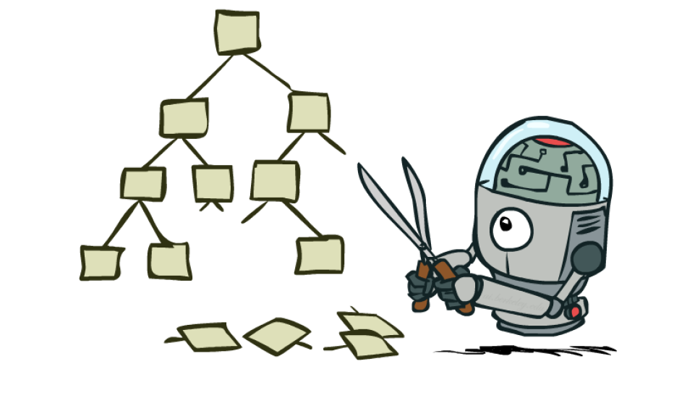
Game Tress Pruning

Slide 24
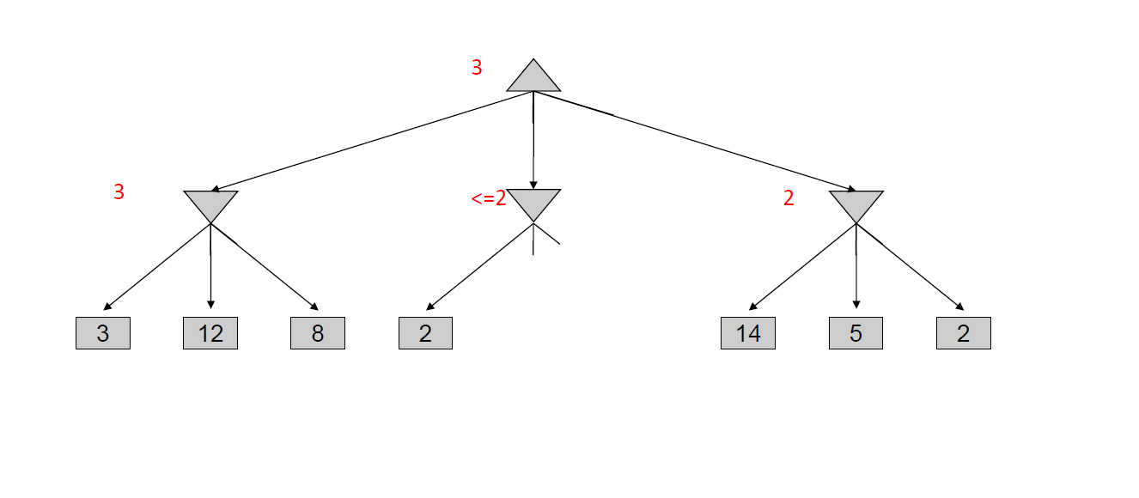
Minimax Example

Slide 25
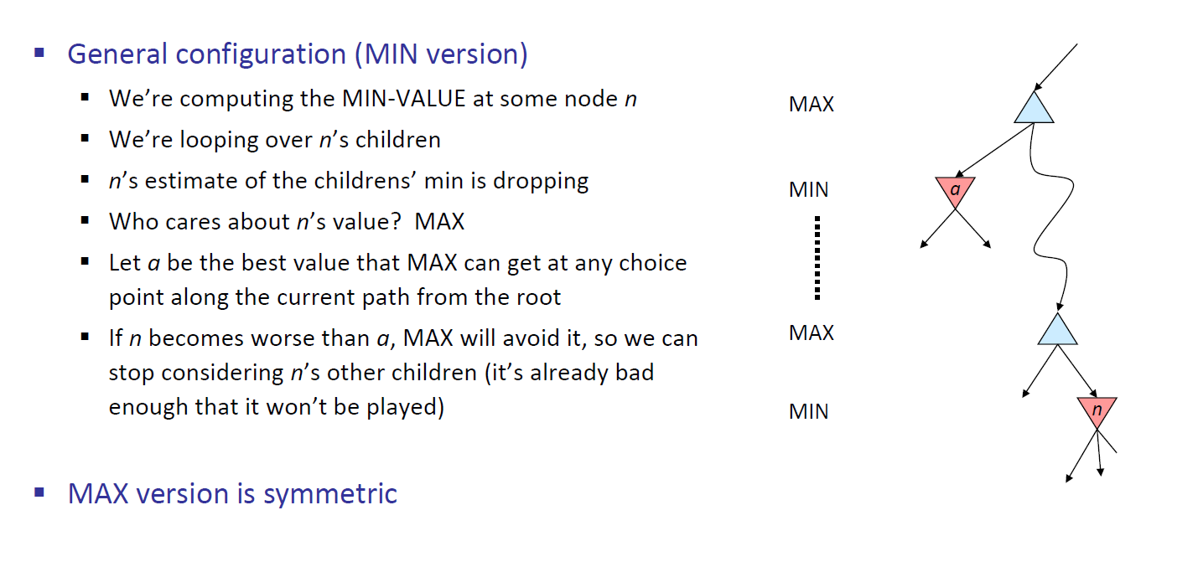
Alpha-Beta Pruning

Slide 26
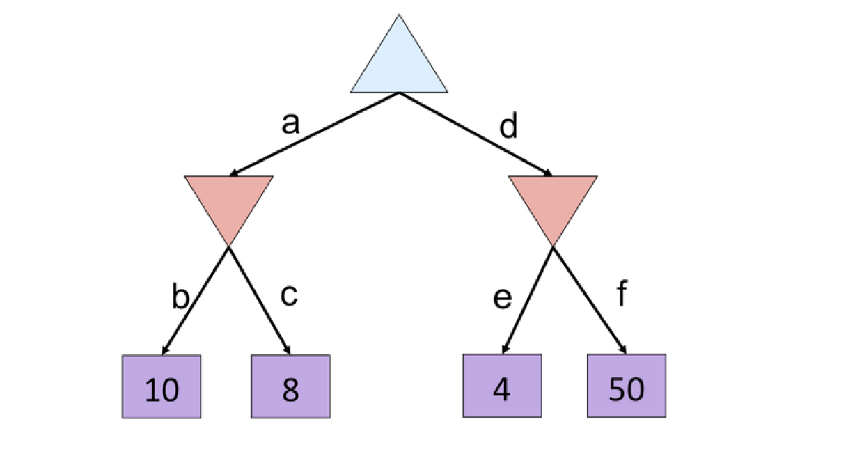
Alpha-Beta

Slide 27
Resource Limits

Slide 28
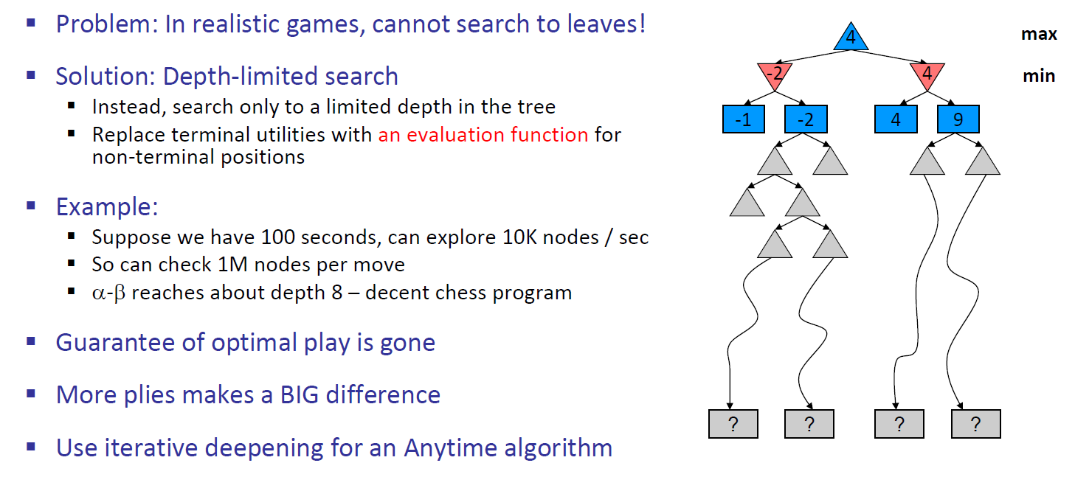
Resource Limits

Slide 29
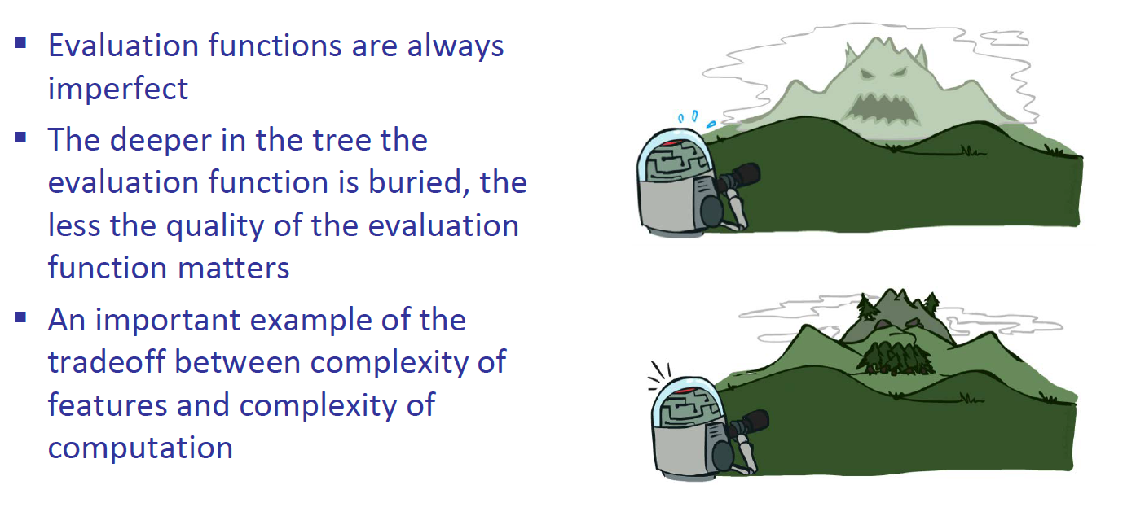
Depth Matters

Slide 30
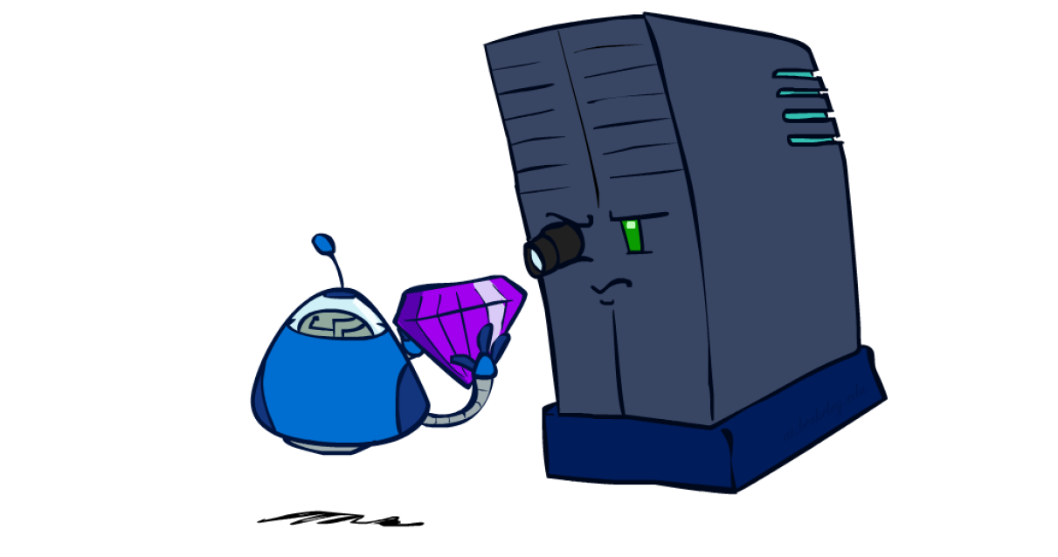
Evaluation Functions

Slide 31
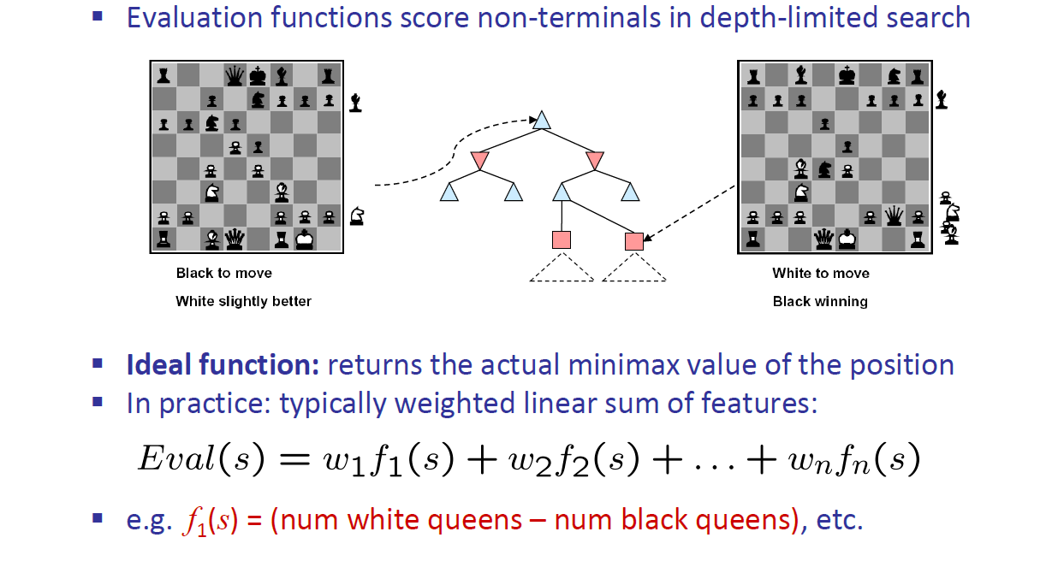
Evaluation Functions

Slide 32
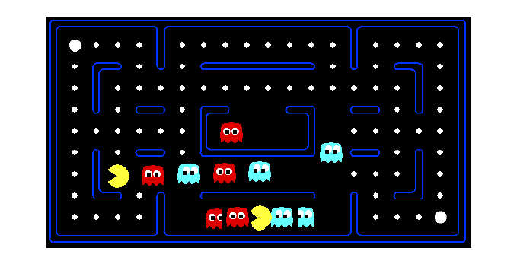
Evaluation For Pacman

Slide 33
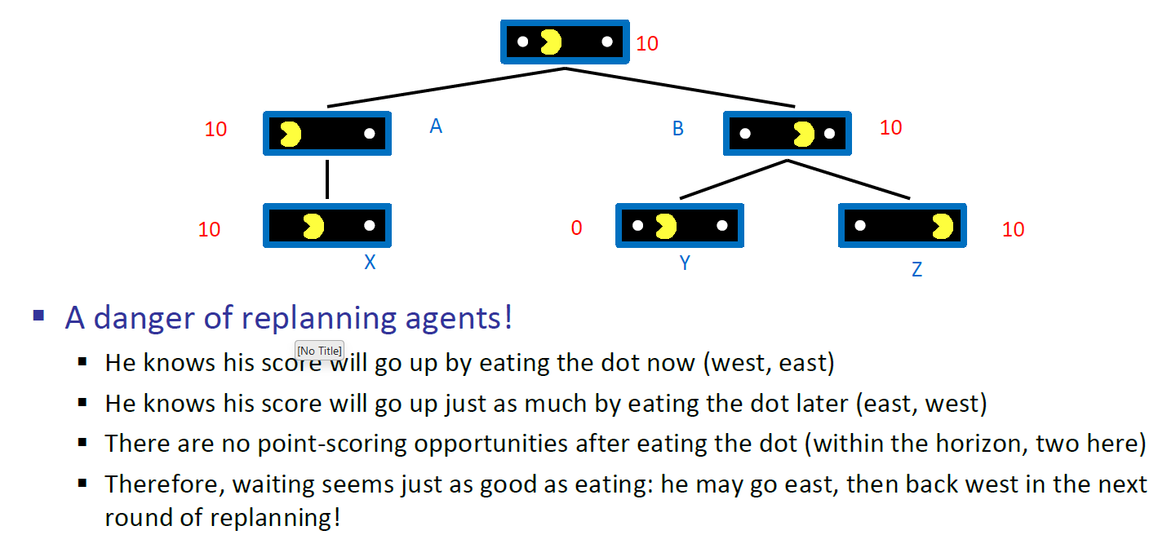
Why Pacman Starves

Slide 34
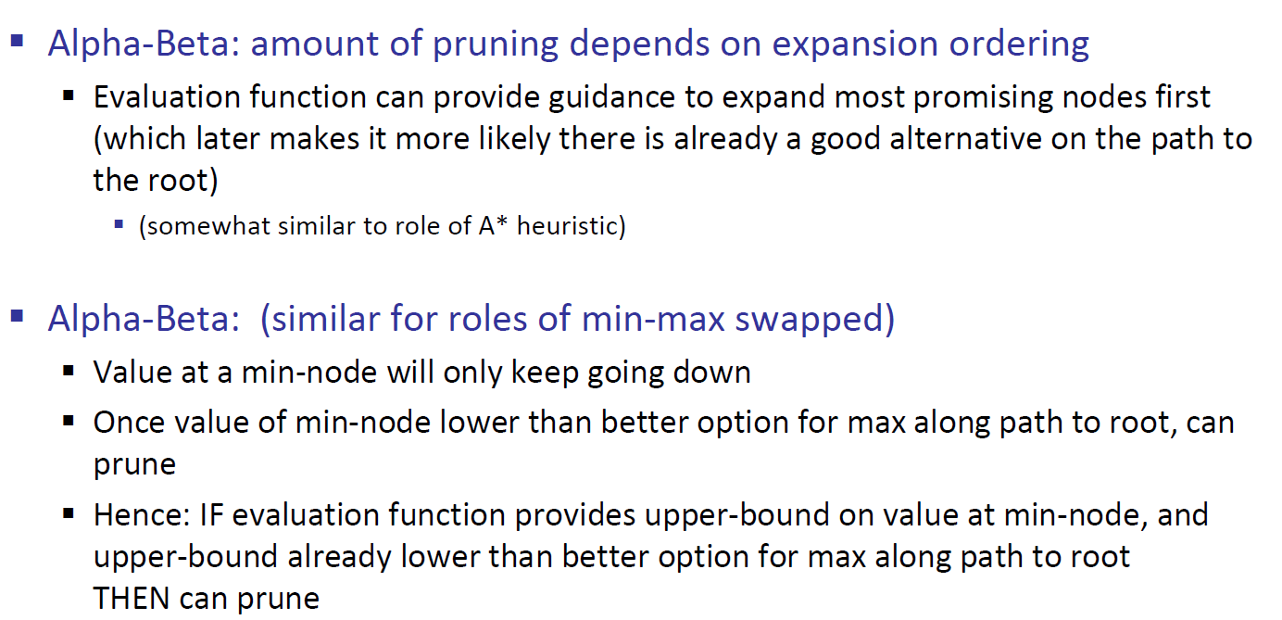
Synergies between Evaluation Function and Alpha-Beta?

